Slide 1
608 Project Presentation Plastic Object Detection Model Comparison
Group 6
Presented By:
Aung Khant Min 30160164
Yi-Chi Chang 30156294
Peerada Tarasub 30178664
Yat Hei Fung 30183611
Hao Su 30191442

Slide 2
1. Overview
Plastics, or synthetic polymers, have been extensively used for commercial, industrial, medicinal and municipal purposes (Lo et al., 2018).
Its disposal becomes a significant environmental concern due to its durability and high resistance to degradation.
The most common method to quantify and characterize beach litter is the visual survey.
Very labor intensive, time consuming, and difficult to carry out on beached that are remote or difficult to access.
Unmanned aerial vehicle (UAV) / aerial drone is implemented for automated image acquisition and image processing.
Three times faster compared to visual survey by identifying from the aligned photos by untrained personnel.
To Further improve the performance and the speed of object detection and identification, deep learning can be implemented.
Notes:
BO

Slide 3
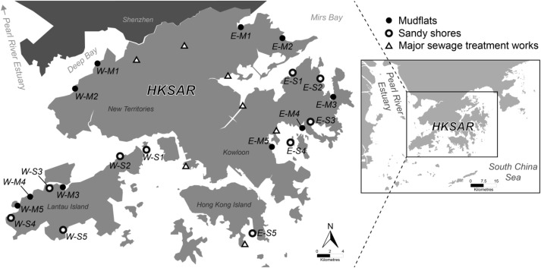
2. Objective
Develop models using different libraries to detect plastic objects on the beach from photos.
Compare the performance of the obtained models in terms of accuracy.
Improve the performance of the obtained models (if applicable)
Implement cloud service (e.g., Google Cloud Platform) for data storage and running models (if applicable)
Notes:
Bo

Slide 4
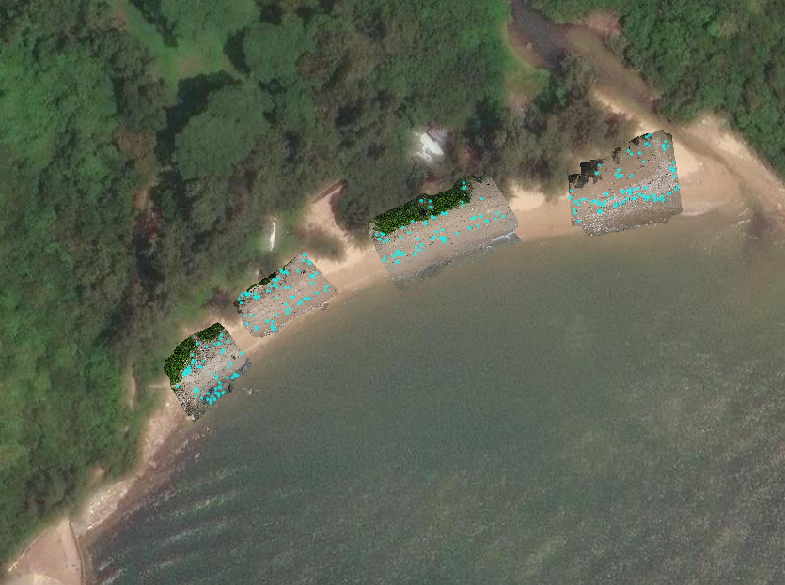
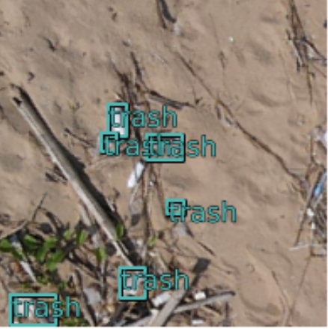
3.1 Dataset: Data Collection
Drone picture of Beaches in Hong Kong. (By researchers in Hong Kong)
Trashes are Manually labeled and sliced into 6000+ images. (By researchers in Hong Kong)
Data Structure: Image + XML file.
<object>
<name>1</name>
<bndbox>
<xmin>95.27</xmin> <ymin>69.51</ymin> <xmax>121.38</xmax> <ymax>98.92</ymax>
</bndbox>
</object>
Notes:
BO
Data is collected from the selected beaches in Hong Kong, along the tidal line
This graph shows one of the sites, the discovery bay
Using aerial drone to take photos from above
Plastic objects, which denote as trash here, are labelled manually
The text at the left shows the coordinate of the object detection region
Blue dots represented the labeled regions
For objects that are misclassified, some corrections can be applied, such as labelling the region as background

Slide 5
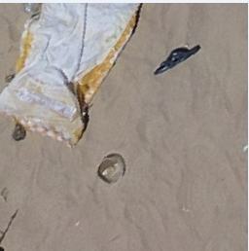
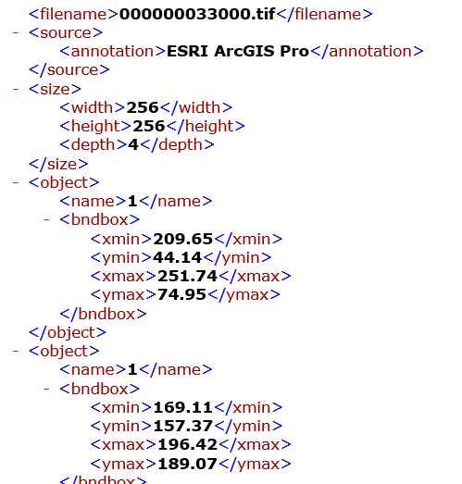
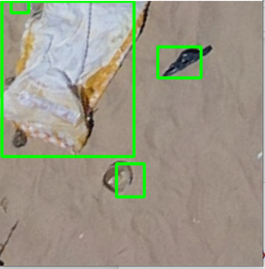
3.2 Dataset: Data Pre-Processing in Python
1
Data cleaning, reading and processing
List of Images
List of Labels
2
Tools
1. ElementTree XML API (xml.etree.ElementTree):
(1) Parse the XML and extract the bounding boxes information.
(2) Save to a dictionary with file name and coordinates of the bounding boxes.
2. OpenCv:
(1) Read the images using cv2 image read()
(2) Save the images to a dictionary with file name and image
(3) Several Image processing(Transform, denoise) were implemented.
Notes:
Data is collected from the selected beaches in Hong Kong, along the tidal line
This graph shows one of the sites, the discovery bay
Using aerial drone to take photos from above
Plastic objects, which denote as trash here, are labelled manually
The text at the left shows the coordinate of the object detection region
Blue dots represented the labeled regions
For objects that are misclassified, some corrections can be applied, such as labelling the region as background

Slide 6
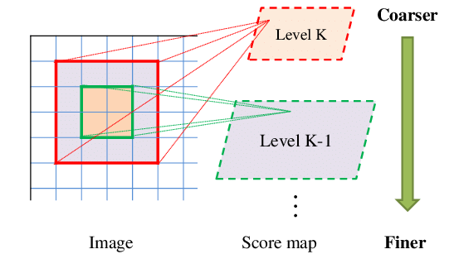
4. Methodology
Compare the performance of Convolutional Neural Network models:
1
Convolutional Neural Network (CNN)
We will be conducting our own model regarding this dataset
For pre-processing, we will be using glob to select multiple images, run data augmentation algorithms, and conducting multiple image transformation techniques:
Distance Transform, Gaussian Blur, FSRCNN (Fast Super Resolution Convolutional Neural Network)
2
Resnet-50-fpn (Faster Region-based Convolutional Neural Network, Faster RCNN)
One of the most advance multi-stage object detectors
Region Proposal Network (RPN) as the algorithm
3
YOLOv8
Developed by Ultralytics
New loss functions for improved training (CIoU loss)
Then, deploy the dataset and algorithm to Google Cloud Platform.
4
Implement cloud services
Notes:
LA
Residual neural network with 50 layers deep
Feature pyramid Network

Slide 7
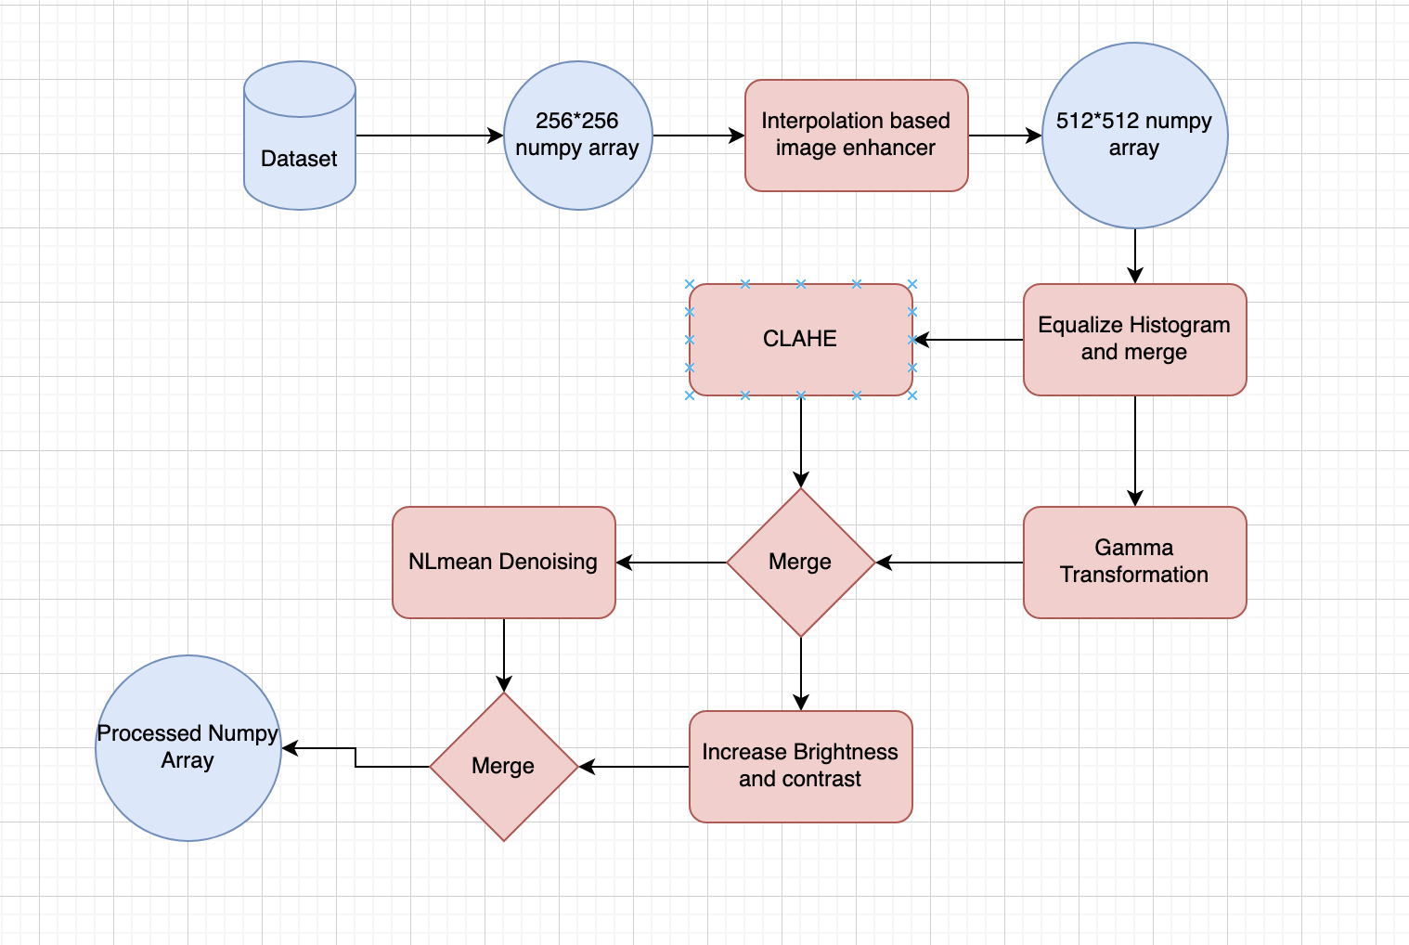
4.0 Image Processing Pipeline– Open CV
Notes:
akm

Slide 8
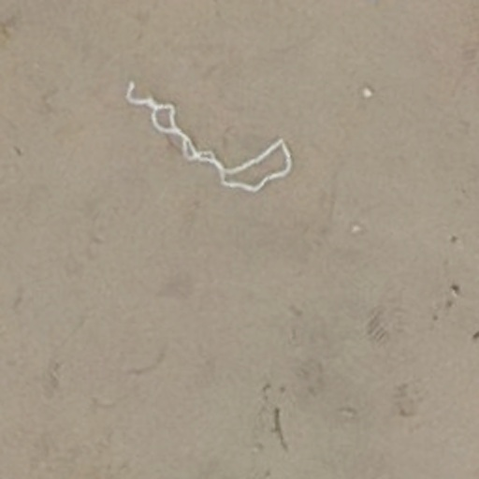
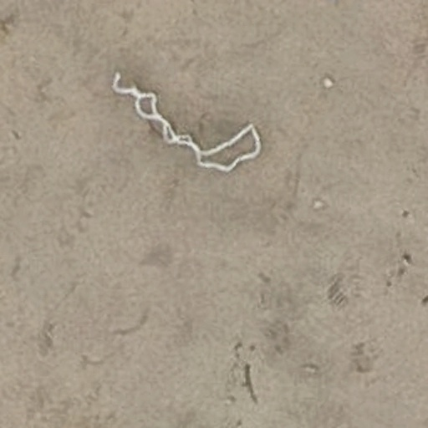
4.0.1 Pipeline process (Cont.)
Gamma Adjustment
Clache
Merged
Notes:
akm

Slide 9
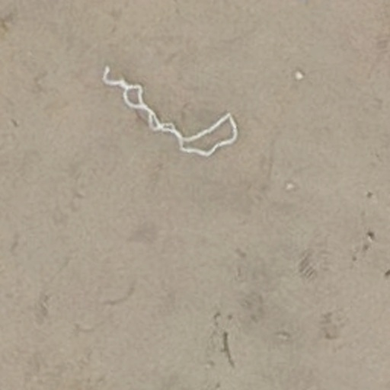
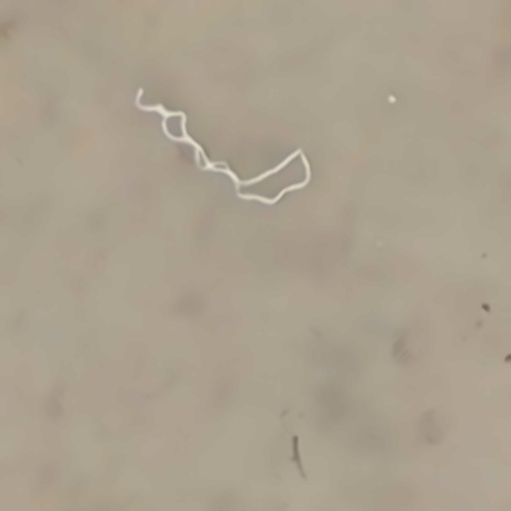
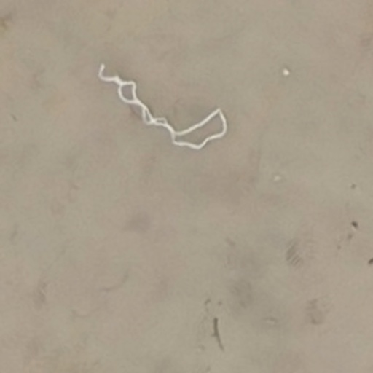
4.0.1 Pipeline process (Cont.)
Brightness and Contrast increased
Denoised
Merged
Notes:
akm

Slide 10
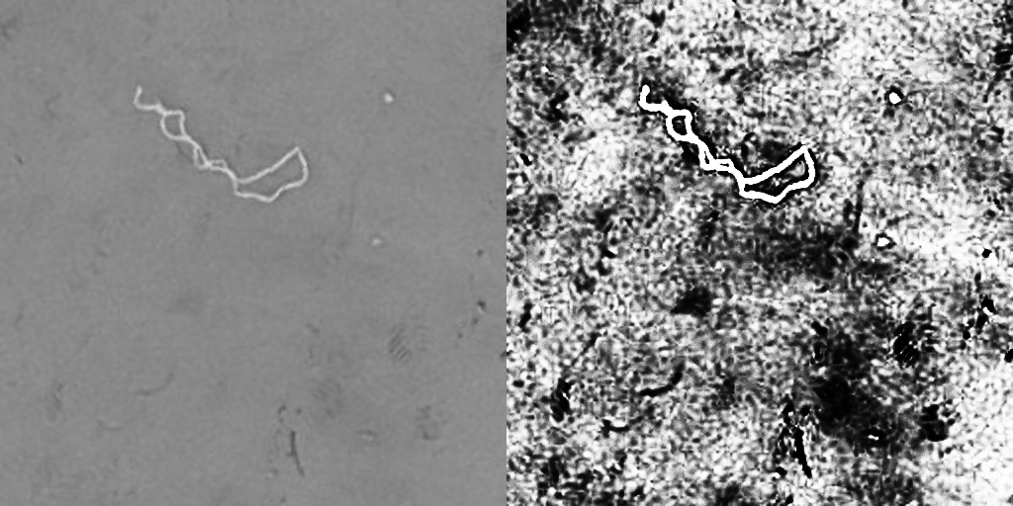
4.0.1 Pipeline process
Notes:
akm

Slide 11
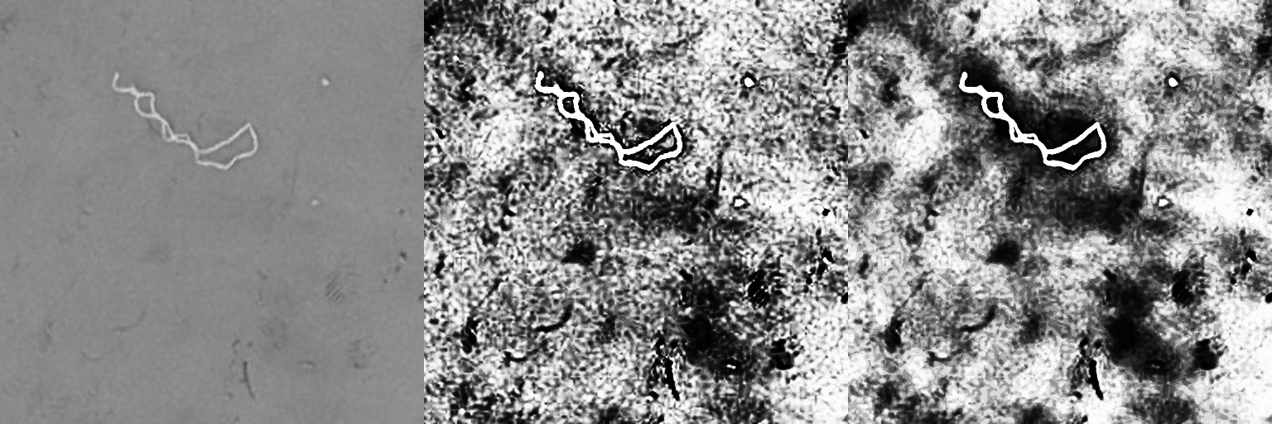
4.0.2 Pipeline Result
Notes:
akm

Slide 12
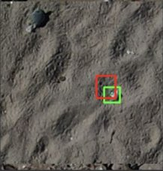
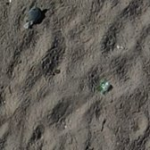
4.1 CNN (TensorFlow)
Dataset
Model
Results
Instantiate the model with CNN Model
Display the Result
Raw Data
(Img & XML)
Wrangle data for the input:
1. Img list
2. label list
Training Set (80%)
Train the Model
Testing Set (20%)
Test the Model
Compare with the other models
Notes:
Leo
After we processed the data, I decided to use a CNN model to try the detection problem. The first step is Splitting the data into training and validation sets. 80% is used for training, and 20% is used for validation. And then normalize the data by scaling the values between 0 and 1. This is a common practice to help the model converge faster during training. For the model part, I defined a Convolutional Neural Network model with three convolutional layers, followed by max-pooling layers. After flattening the output, two dense layers are added. The last dense layer has 4 output neurons and a linear activation function. Compiling the model using the Adam optimizer with a learning rate of 0.001, a mean squared error loss function, and tracking the accuracy metric. At last, training the model for 10 epochs, using the training data and evaluating the model performance on the validation data.
For simplicity, in this model I select only one bounding box to identify the plastic and output one bounding box.
Take this picture as an example, the green box is the original label and the red box is the output of the model. It seems that the model can successfully detect the plastic on the beach. However, in some other cases, it makes very wrong detections. I think this problem may be due to the fact that there are many wrong labels in the data and more time is needed to adjust the model.

Slide 13
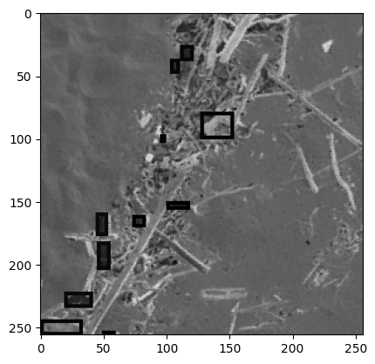
4.2 Faster RCNN Resnet50 FPN V2
1
Faster RCNN Resnet50 FPN V2 Model using PyTorch
Dataset
Model
Results
Instantiate the model with Faster RCNN Resnet50 FPN V2
Display the Result
Raw Data
Normalized Data in Tensor Form
Training Set (80%)
20%
Load with PyTorch’s DataLoader
Testing Set (20%)
Transform
Train the Model
80%
Test the Model
Compare with the other models
Notes:
pp
Next, I decided to use the Faster RCNN Resnet50 FPN V2. The model was implemented using PyTorch library.
Firstly, the whole raw dataset will be transformed into tensor form and then will be normalized so that it will be ready for further analysis. Then, because the dataset is very large, I loaded all dataset with PyTorch’s DataLoader with num_workers = 2, and batch_size = 25. At first, I split the whole dataset into 80% of training set and 20% of testing set and parse them into the model, but it took 4 hrs to complete the testing part. So, I repeated the process again by randomly picking just 20% of the whole dataset and split it into the training and testing set. After getting everything done, I displayed the results but they were not as expected. The bounding boxes on each photo appear to be unacceptably wrong. In order to improve this, I might need to tune the model over again and because of the lack of the time, I decided not to compute any accuracy score and will not move further with this model.

Slide 14
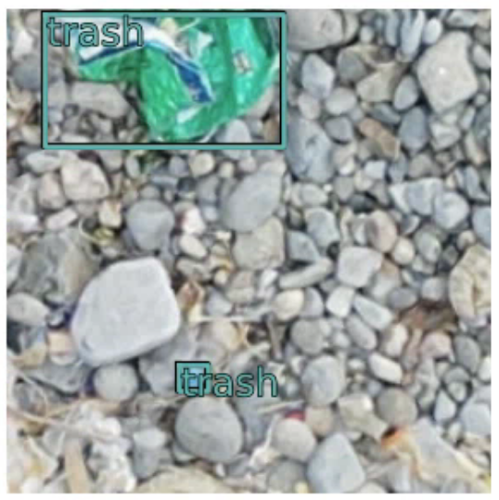
4.2 Faster RCNN Resnet50 RPN
2
Faster RCNN using ArcPy
Dataset
Model
Results
Display the Result
Raw Data
Processed Data
Instantiate the model with Faster RCNN
Using Arcgis’s prepare_data() to pre-process the images e.g., rescale, sheer, rotate, flip the images
90% Training Data, 10% Validation Data
Fit the Model
Compare with the other models
Model | epoch | train_loss | valid_loss | average_precision
Faster RCNN (AcrPy) | 20 | 0.331076 | 0. 433003 | 0. 308102
Notes:
Bo
Here I tried to use the Faster RCNN Resnet50 RPN. The model was implemented using Arcpy library provided by Arcgis Pro.
Firstly, the whole raw dataset are preprocessed by the prepare_data() function, which includes rescale, sheer, rotate, flip the images, and then split the data by default. Then, I used faster RCNN to train the model for 20 epoch, and some trash is detected, but the precision is not high.

Slide 15
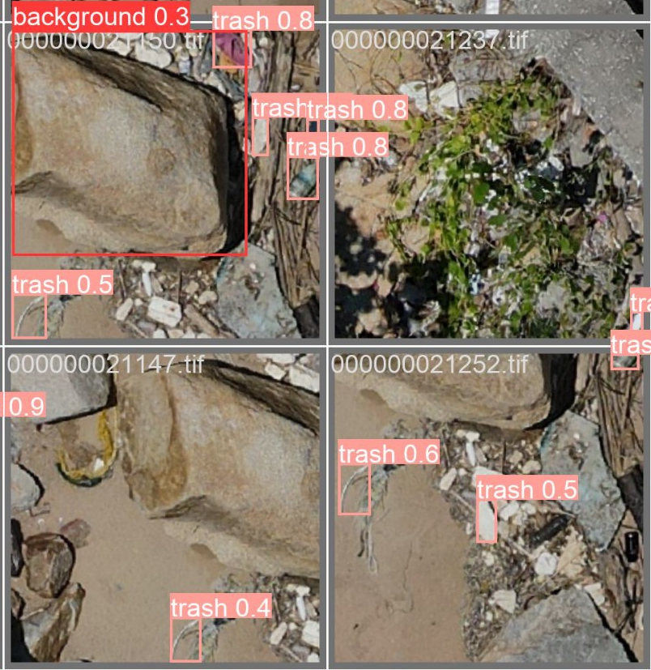
4.3 YOLOv8 (You Only Look Once)
Dataset
Model
Results
Instantiate a pretrained model with YOLOv8l.pt
Display the Result
Raw Data
Training Set (70%)
Split the data and assign into different folders
Setup the YAML files for training
Train the Model
Testing Set (10%)
Setup the YAML files for validation
Validate the Model
Validation Set (20%)
Test the Model and predict objects
Compare with the other models
Model | epoch | train_loss | valid_loss | average_precision
YOLOv8 | 20 | 3.8806 | 4.454 | 0.54612
Notes:
bo
Here I am going to discuss the implementation of YOLOv8 which has different architecture with Single-stage detection. Instead of resnet50 RCNN, the backbone network is CSPDarknet53 that is an enhanced version of the Darknet53 network with Cross Stage Hierarchical (CSP) connections for better gradient flow and feature fusion, providing strong feature extraction capabilities. Since the data is exported from Acrgis Pro, it includes tiff, tfw image files and xml label files while yolo only uptake image and txt format label, xml files are converted to txt. Then, the data is split into 3 parts, training, testing, and validation sets. After that, a pretrained model YOLOv8l provided by Ultralytics is used to train and validate the model with 20 epoch, and then test the model predict objects on the photo. From the results, you can see that some objects are labeled by rectangles, in which the number is representing the confidence that classification, and the trash is mostly classified correctly. The average precision is 0.5461.

Slide 16
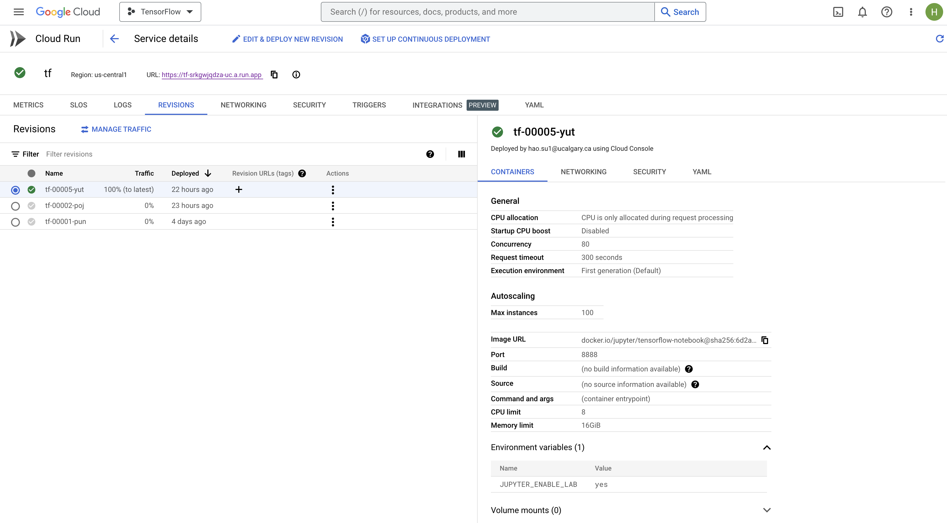
4.4 Implement Cloud Service
Easy-to-use and maintain
Cost-effective
High-performance hardware
Collaboration and sharing
Notes:
Leo
I deployed a jupyter/tensorflow-notebook image to google cloud platform, because of Easy-to-use and maintain, Cost-effective, High-performance hardware
and Collaboration and sharing.
,

Slide 17
5. Conclusion
1
Model Comparison
Model | epoch | train_loss | valid_loss | average_precision
CNN | 10 | 6880.3696 | 6823.4814 | 52.36%
CNN (With Processed Image) | 7 | 6526.1787 | 6442.1226 | 58.15%
Faster RCNN | 20 | 0.331076 | 0. 433003 | 30.81%
YOLOv8 | 20 | 3.8806 | 4.454 | 54.61%
Using different loss functions
CNN: Smooth L1 loss, a type of regression loss that measure the difference between bounding box coordinates and true labels.
Faster R-CNN: uses a combination of classification loss (e.g., cross-entropy loss) and regression loss (e.g., Smooth L1 loss) to measure the difference between predicted object classes, bounding box coordinates, and true labels.
YOLOv8: uses total train loss that sum up box loss, class loss, and dfl_loss computed on the training dataset.
CNN
Faster RCNN (ArcPy)
YOLO
Notes:
1-LA

Slide 18
6. Challenges & Next Steps
1
Challenges
Some original photos were mislabeled, lead to the wrong object detection results.
There are more than 6000 photos in the dataset, which is around 1.22 GB in total, lead to drastically long runtime when developing and testing the model, as well as high CPU & GPU consumption.
2
Next Steps
Improve the accuracy of the label in the original dataset.
Export the data in different format.
Fine-tune the current model parameters.
Transfer the dataset to Google Cloud Storage and run the model on GCP.
Deploy GCS (Docker) that linked to a local file for instant updates.
Expand the scope by implementing other object detection models.
Notes:
pp

Slide 19
6. Individual Learning Objectives
 | Learning Objectives | Status
Yi-Chi Chang | Learn how to apply OpenCV to read, show, resize and process the images picture by wrangling 6,000+ images for this project by 31 March 2023.
 | Learn how to parse XML file with xml tree package in Python by parsing the 6,000+ labels dataset for this project for the preparation of the CNN model by 31 March 2023.
Aung Khant Min | To enhance my understanding of image processing, I used glob, opencv, multiprocessing and scripting techniques to process all the images for passing into Leo's CNN.
 | To learn how to use tensorflow for deep learning, I assisted Leo and Lawrence by debugging the CNN model's problems and testing the model they built with different data.
Hao Su | Train the CNN model and choose the suitable number of layers and neurons and suitable activation functions by 31 March 2023.
 | Learn how to use cloud services by deploy the project on GCP by 7 April 2023.
Peerada Tarasub | Learn how to perform object detection by implementing Faster RCNN model using PyTorch library and able to obtain the output by 31 March 2023.
Yat Hei Fung | Learn and implement the related libraries (Arcpy and Yolov8) for object detection model development.
 | Familiarize and compare different Neural Network models for object detection modelling.
Notes:
everyone

Slide 20
5. Conclusion
2
Cloud Deployment
Deployed the trained CNN model on Google Cloud Vertax AI Platform.
Transform the image data to Jsonl format for prediction purpose.
The cloud environment shut down after we used up all the credit.
Notes:
LEO
For the cloud service part, we thought put our trained model on the cloud maybe more meaningful. So we deployed our trained cnn model on Gooogle cloud vertax ai platform. We transferred our test images to the jsonl format file and try to predict. Unfortunately, it failed. After that, the google cloud was shut down because the prediction task used all the remaining credit.

Slide 21
Q & A

Slide 22
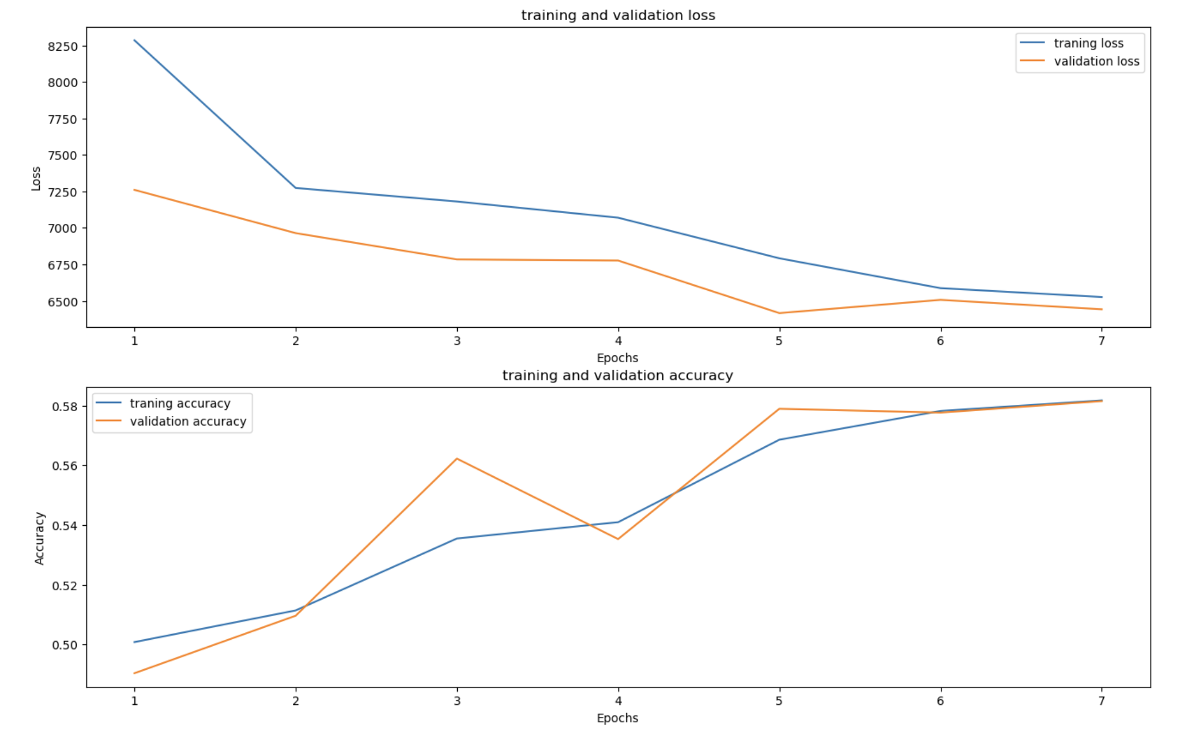
Model-Related Question
Question 1
The CNN trained with 10 epochs but others trained with 20. Is that fair when you compare the models?
After several trial and error, we found the validation loss will increase after around 10 epochs.
By implement early stopping method to avoid overfitting, the training process stopped at 7 epochs.
Notes:
Leo
For question 1, It was the first time we built a cnn model, we tried 20 epochs at first, and then we found that the validation loss increased after about 10 epochs. To prevent overfitting, we set 10 epochs.
And then, we add the early stopping to the model, after that it stopped at 7 epochs.

Slide 23
Model-Related Question
Question 2
There were more than 6000 photos and about size of 1.22 GB. Have you tried to compress it, or do anything to reduce the size?
We did not compress the photos. We kept it at 256*256*3 as is. The training time is not that long for now. The laptop we use for the CNN process has 32 Gb ram and swap, and another remote computer has 48 Gb ram. We can finish the training process within 1 minute for CNN.
Question 3
Where did you build the model, considering it would have required large memory for processing(we were having memory issues for our other project), and how did you address it.
For image processing, we separated the image to four segments and ran it on four laptops at the same time.
For model building, we used the laptop with 32 Gb ram and another remote computer with 48 Gb ram to build models.
Notes:
Leo
For question 2, We did not compress the photos. The laptop we use for the CNN process has 32 Gb ram and the swap function which makes the SSD a part of ram. So when we ran the cnn model, it took 100gb ram. And also we have a remote computer with 48gb ram.
For question 3, For image processing, we separated the image to four segments and ran it on four laptops at the same time.
For model buiding, we use the laptop to build cnn model, the remote computer for yolo model, and google colab for faster rcnn model. We cannot use the whole data in colab, and then we saw the bad result from faster rcnn, so we just throw it away. But cnn and yolo model can run very well in the laptop and the remote computer.

Slide 24
Model-Related Question
Question 4
At the beginning of the presentation, you mentioned that you were going to develop a CNN by yourselves. Did this mean make a CNN by scratch, or using tensorflow?
If you made it by scratch, how difficult was it? How long did it take you to make it? Do you have any advice to share after the experience?
We did mention that we were going to develop a CNN ourselves, but we meant to say "we are going to develop a CNN using Tensorflow". We did not make a CNN from scratch.
Notes:
Leo

Slide 25
Dataset-Related Question
Question 5
Were there any discrepancies or inconsistencies in the labeling of the images? If yes, how did you address these issues? Basically, how did the quality and consistency of the labeling impact the performance of the object detection models? Were there any specific challenges that you faced due to the labeled images which were done manually?
There were some cases of discrepancies in the labeling of the image. We took out the images that is completely dark and completely white. There were also pictures with pure noise. For instance, we ran into multiple pictures with no plastic and filled with foliage. We decided to take those images out. We ended up with 3892 clean image data in total. Even within the 3892, we faced some inconsistency in labeling. We had some dirty data within the dataset. Some of the labels are off by a couple pixels. Lawrence fixed the ones we found manually. As for the rest, we cannot spend time fixing the images manually so, we decided to train the model as is and got the results. It does definitely affect the performance of the object detection. Even with a couple mislabeled data, our model's accuracy can be greatly impacted. With our current model, we believe that our accuracy is only 58% due to those data points. The model draws the bounding box correctly on some pictures but also pick out random areas for some pictures due to these mislabeled images.
Notes:
La

Slide 26
Model-Related Question
Question 6
With models having such long run times, did you run into any time constraint issues? Did you find that models would run for long periods, and error out? What was the process of working around those long runtimes?
With our CNN model, we did not have run time problems and constraint issues as it only takes around 1 minute to run the model. However, we did have long run time issues with processing of the images. We tried passing in all 6000 images into the image processing pipeline. At first, we didn’t use tqdm for running the code chunk. We waited 6 hours until we turn the code off and try to figure it out. We thought it was a problem with jupyter notebook so, we tried on google colab with multi-processing and threading. In colab, the code was constantly stuck at wait() command whenever I tried to debug. The wait is too long so, we kept trying and fixing and waiting. At last, we used tqdm with trange to find out that the processing will take around 20 hours to finish. At that point, we decided to do a computer cluster with all our laptops combined. We decided to process a number of images and labels on each member's computer and combined it back using hard drive.
Notes:
La

Slide 27
Model-Related Question
Question 7
Why there is such a result in the faster r-cnn part. Is this because data is not enough since only 20% of the data set is selected? Or is it caused by the wrong label in the dataset?
We think those reasons all contributed to such results. However, the wrong label in the dataset might be the main cause. Also, we may have to experiment with different hyperparameters, such as adjust the learning rate, batch size, or optimization algorithm to improve the model's learning process and obtain the better results.
Question 8
How much do you think the model accuracy is affected by the composition of the beach?
To be honest, we found that there is a lot of noise in the picture as there are also rocks, woods, and plants. It certainly made it a lot trickier to classify plastic. If it were just water and sand, we believe that our model would have a much higher accuracy. I think you can see in the edge detection image that the plastic is very distinct in the pictures but at the same time, the noises are also somewhat distinct. As a result, we believe that the composition of the beach affects the model accuracy in a negative way.
Notes:
PP

Slide 28
Model-Related Question
Question 9
The training loss for the CNN model is considerably higher compared to the other two models. Despite this, its precision is higher than the R-CNN and on par with YOLO. Have you looked into the possible reasons for this intriguing outcome?
Each model use different loss function, which will lead to a different scale of loss value, making the loss value not comparable.
Model | Loss function
CNN | L = 1/N * ∑i=1:N [smooth_L1(Δx_i) + smooth_L1(Δy_i) + smooth_L1(Δw_i) + smooth_L1(Δh_i)
Faster RCNN | L_cls_fast + λ * L_reg_fast
YOLO | L_total = λ_box * L_box + λ_obj * L_obj + λ_cls * L_cls
Data quality: In CNN, we only keep one object bounding box in one image for training. The original training data might be too noisy for faster RCNN and YOLO.
Notes:
PP
Loss: Diff loss fx -> diff scale of loss val -> can’t just simply compare them. Even tho the number of those for CNN is high, but it’s cannot be compared with the rest of the models’ results.
Acc : the possible reason might be because we only keep one bounding box in one image, but did not do so for the rest of the models because there’s the difference in pre-processing of the training data.

Slide 29
THANK YOU

Slide 30
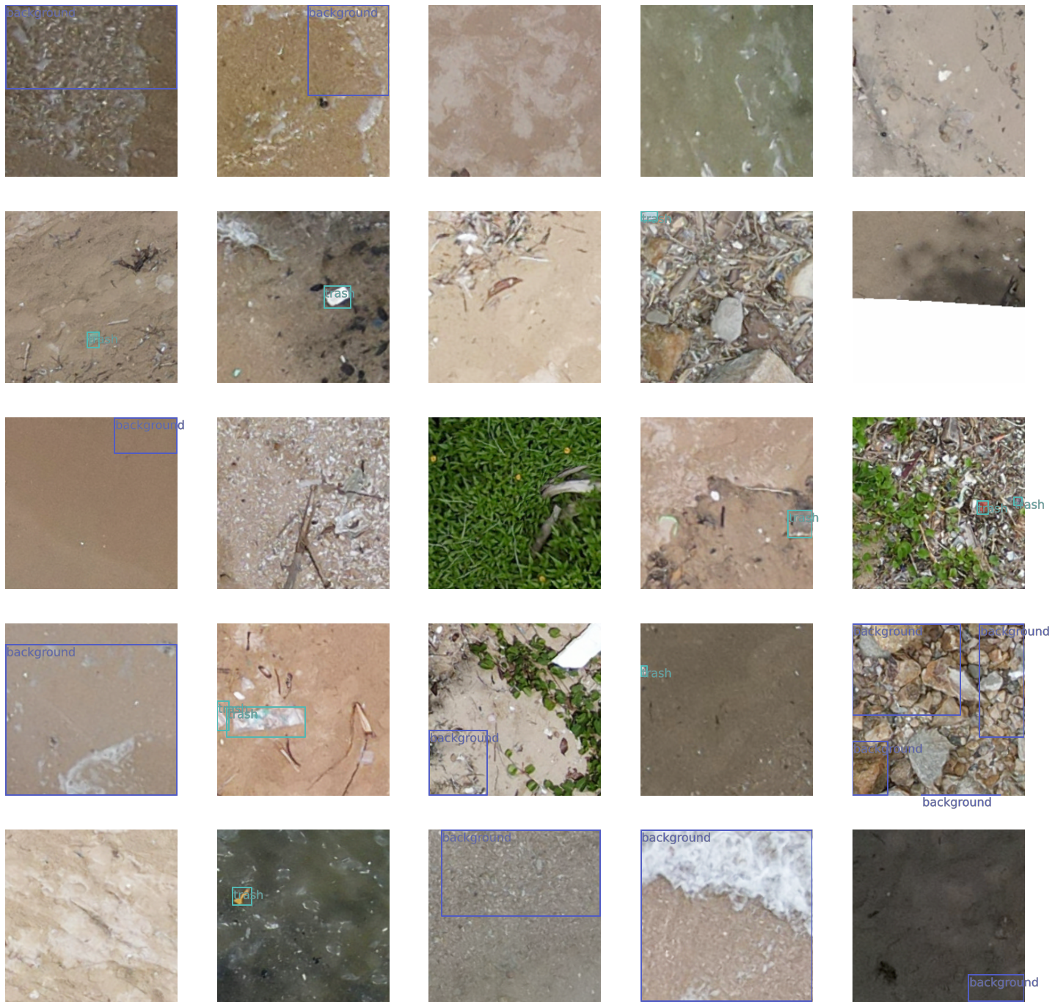
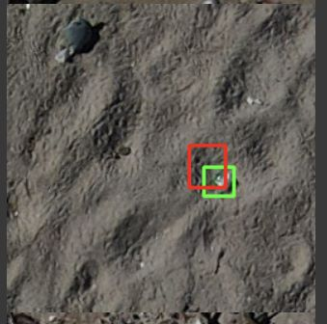
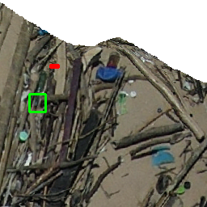
Current Status & Future
Faster RCNN (arcpy)
Deploy GCS (Docker) that linked to a local file for instant updates
Use other object detection models
Finetune the model parameters
Export the data in different format or label it manually on images with different format (Not feasible)
CNN
Correct labelling
Incorrect labelling

Slide 31
References
Lo, H. S., Xu, X., Wong, C. Y., & Cheung, S. G. (2018). Comparisons of microplastic pollution between mudflats and sandy beaches in Hong Kong. Environmental Pollution, 236, 208-217.
https://developers.arcgis.com/python/api-reference/arcgis.learn.toc.html#fasterrcnn
https://developers.arcgis.com/python/guide/faster-rcnn-object-detector/
Notes:
pp

